Slide 1
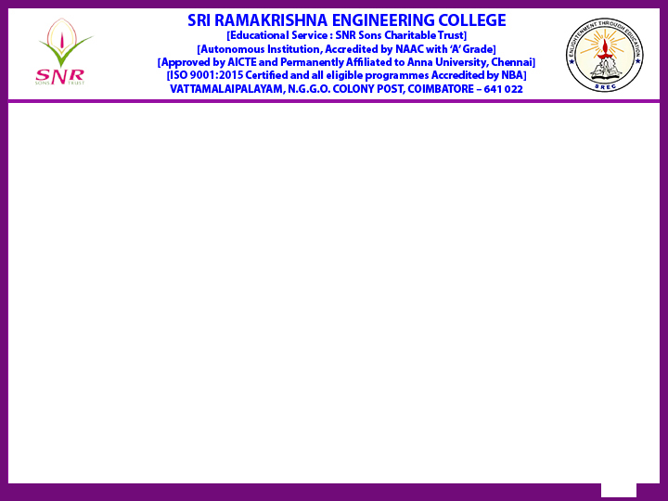
Reaccredited by NAAC with A+ grade]
Batch No: 22
Dept: CSE
20CS296 – Mini Project II
Mission-Critical Fire Detection and Severity Classification for Industrial Operations
Type of Project: Society Based
Presented by
G R Mohan Krishna – 2253035
Dhiyanesh R – 2253013
Supervised by
Mrs. C. Sowntharya
AP/CSE
Review :Review III
Date : 12.04.2025

Slide 2
Contents
S.No | Description | Slide Number
1 | Introduction | 3
2 | Problem identification, scope and objective | 4-5
3 | Literature Survey | 6-10
4 | Existing technology of the project | 11-12
5 | Methodology | 13
6 | Design & Experimentation carried during the review period | 14 - 15
7 | Results obtained till date | 16 – 20
8 | Upgradtion | 21
9 | Proposed Outcome of the Projects | 22
10 | Participation in events (Patent, Paper, Hackatons etc.,) – applied / published / granted | 23
11 | References | 24

Slide 3
Introduction
MISSION-CRITICAL FIRE DETECTION AND SEVERITY CLASSIFICATION FOR INDUSTRIAL OPERATIONS
Industrial environments face significant risks from fires, leading to potential loss of life, property, and production.
Traditional fire detection systems rely on fixed sensors (smoke, heat) which often have slow response times and limited coverage.
High False Alarm Rates
Inefficient Fire Detection Systems
Business Losses: Annual revenue loss due to false alarms
Reputation Damage

Slide 4
Problem identification, scope and objectives (Contd.,)
Problem Definition
Inadequate detection accuracy and delayed response in current industrial fire detection systems.
High false alarm rates and inability to scale across large industrial sites.
Using camera to detect if it’s "Real Alarm" Or "False Alarm"
If "Real Alarm" then indicate the severity of Alarm High/Medium/Low.
Operate in real-time
Scope
Fire Detection, Severity Classification, Edge Deployment, Real-time video analytics.

Slide 5
Problem identification, scope and objectives
Achieve real-time fire detection with high mAP. (unbiased towards fire at any scale)
Classify the severity of fire (Based on: Industrial perspective)
Implement a scalable algorithm/application
Objectives

Slide 6
Literature Survey – 01
Experiment | Inference | Problem gap
The study evaluated pre-trained models using feature extraction and fine-tuning. Experiments involved adding classifiers to VGG16, InceptionV3, and Xception. Early stopping was applied during model training . Confusion matrices were used to assess model performance | The models were evaluated using accuracy, precision, recall, and F1-score. Xception achieved 98.72% accuracy on the dataset. Without LwF, Xception had 79.23% accuracy on a new task | Gaps in CNN application include faster training and hyperparameter tuning Limited studies on tuning hyperparameters for fire/smoke detection Need for better transfer learning methods on new datasets
Source: V. E. Sathishkumar, J. Cho, M. Subramanian, and O. S. Naren, "Forest fire and smoke detection using deep learning-based learning without forgetting," Fire Ecology, vol. 19, no. 1, Article 9, Feb. 2023.

Slide 7
Literature Survey - 02
Experiment | Inference | Problem gap
The paper proposes a novel fire detection approach using ViT with YOLOv5s The model detects fire and smoke with bounding boxes and confidence scores Aims to improves detection accuracy in complex environments | Results show a mAP@0.5 of 0.664 and recall of 0.657 The modified model outperforms baseline YOLOv5 variants The model's attention mechanism introduces computational overhead | Expanding the dataset for diverse environments and fire types is needed. Future work could optimize model efficiency and scalability. Performance under low-light and foggy conditions requires further refinement.
Source: F. Safarov, S. Muksimova, M. Kamoliddin, and Y. I. Cho, "Fire and Smoke Detection in Complex Environments," Fire, vol. 7, no. 11, p. 389, Oct. 2024.

Slide 8
Literature Survey - 03
Source: A. Namburu, P. Selvaraj, S. Mohan, S. Ragavanantham, and E. T. Eldin, "Forest Fire Identification in UAV Imagery Using X-MobileNet," Electronics, vol. 12, no. 3, p. 733, Feb. 2023.
Experiment | Inference | Problem gap
The study focuses on forest fire detection using UAVs. The method utilizes MobileNetV2 for low-resource devices like drones The experiments were conducted using Python and TensorFlow | Transfer learning optimizes MobileNet for fire detection tasks. UAVs provide low-cost, efficient monitoring of wildfires X-MobileNet achieves 97.26% accuracy in fire classification | Has minimal domain adaptation techniques Real-time processing on low-power edge devices is not deeply explored No mention of multi-scale fire detection.

Slide 9
Literature Survey - 04
Experiment | Inference | Problem gap
The paper discusses efficient streaming services in edge computing environments It integrates DeepStream, Simple Realtime Server, and Docker technologies | The YOLOv4 image recognition environment was built for inference on Ubuntu 18.04.6LTS WebRTC achieves low latency, while HLS has higher delays | Further testing for cross-platform compatibility is required. Limited compatibility matrix, forced to degrade advanced and state-of-the-art models.
Source: W.-C. Shih, Z.-Y. Wang, E. Kristiani, Y.-J. Hsieh, Y.-H. Sung, C.-H. Li, and C.-T. Yang, "The Construction of a Stream Service Application with DeepStream and Simple Realtime Server Using Containerization for Edge Computing," Sensors, vol. 25, no. 1, p. 259, Jan. 2025.

Slide 10
Literature Survey - 05
Source: S. P. Yadav, M. Jindal, P. Rani, V. H. C. de Albuquerque, C. dos S. Nascimento, and M. Kumar, “An improved deep learning-based optimal object detection system from images,” Multimedia Tools and Applications, Sep. 2023
Experiment | Inference | Problem gap
Compared three different deep learning object detection algorithms. Evaluation Metrics: Accuracy, Recall, Precision, Loss: | The findings indicated that R-CNN techniques are superior in terms of the evaluated metrics. Trade-offs between speed and precision in object detection algorithms. | Doesn’t compare the integration technologies. Should Examine the scalability of these algorithms to larger datasets and their ability to generalize across different domains.

Slide 11
Existing technology of the project
Current Methods:
Fixed Sensor Systems: Smoke/heat detectors used in buildings; limited by static coverage.
Basic AI Systems: Early-stage deep learning models trained on static images with limited real-time capabilities.
Gaps in Existing Technologies:
High False Positive, Biased towards scale of fire.
Latency Issues: Traditional methods often exceed acceptable delay thresholds for emergency response.
Scalability Problems: Inability to handle multi-UAV data streams effectively.
Integration Shortcomings: Lack of seamless connectivity between detection, notification, and visualization platforms.

Slide 12
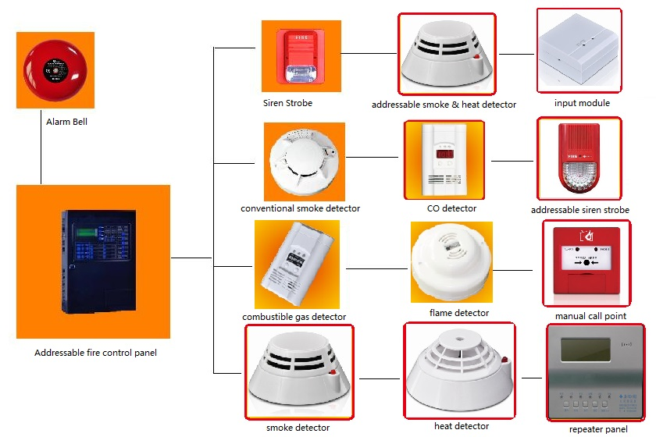
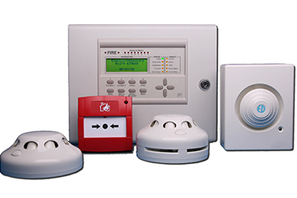
Existing technology of the project
Photographs
1.

Slide 13
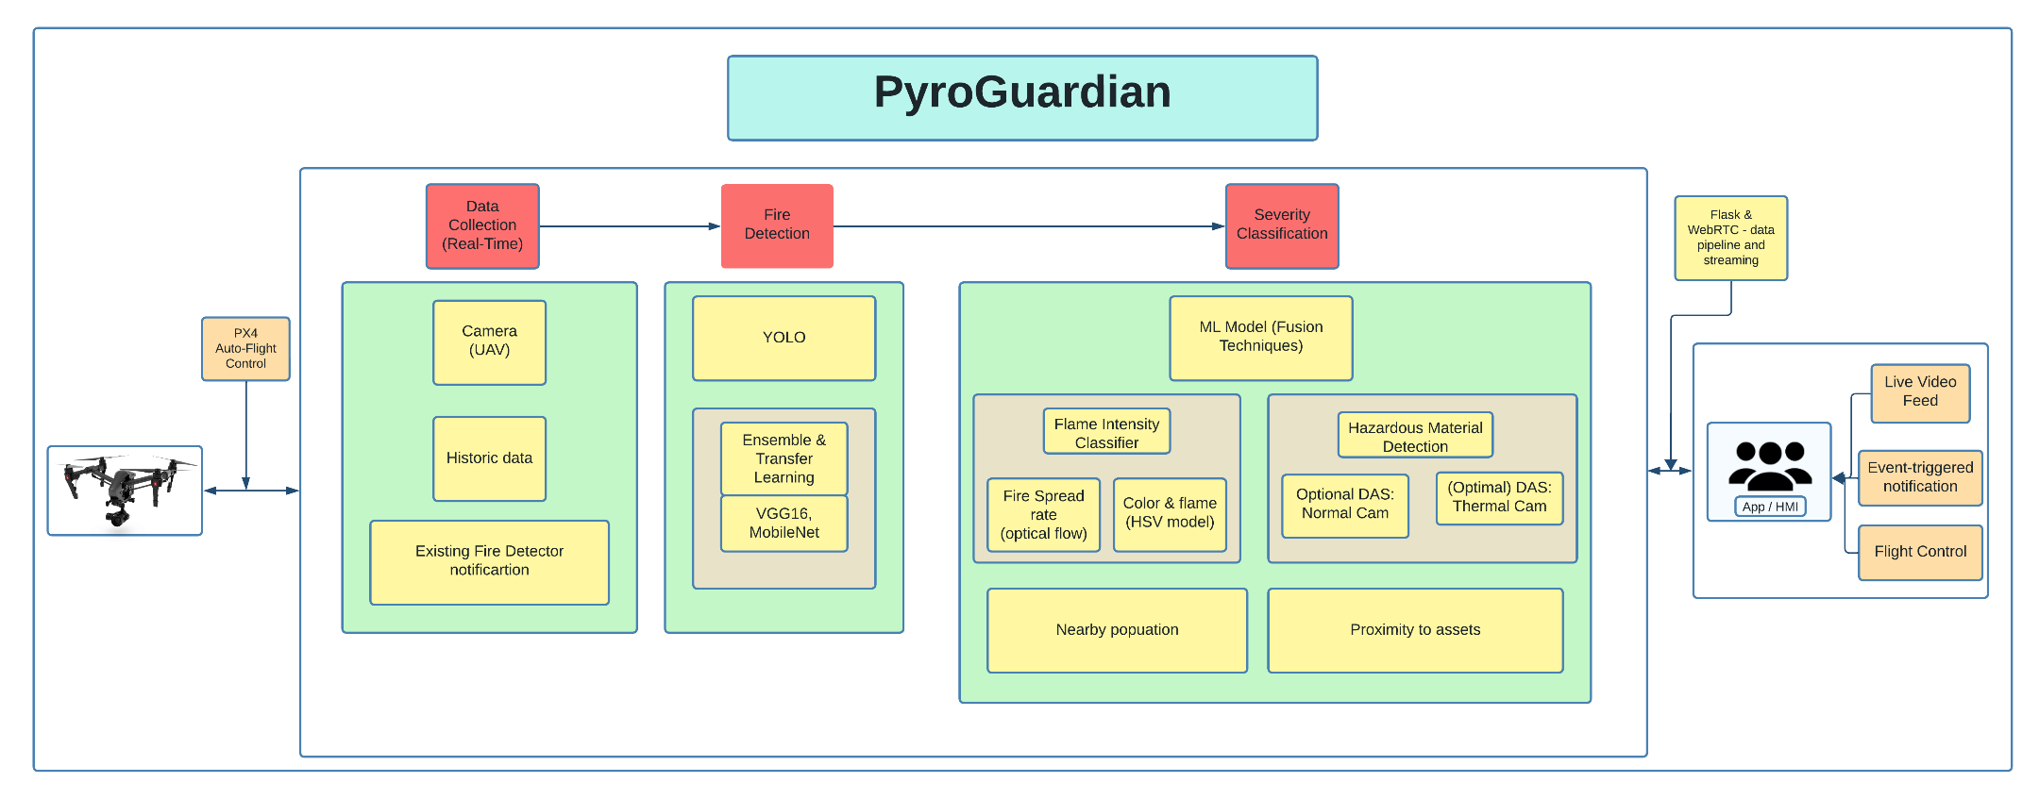
Methodology to be adopted

Slide 14
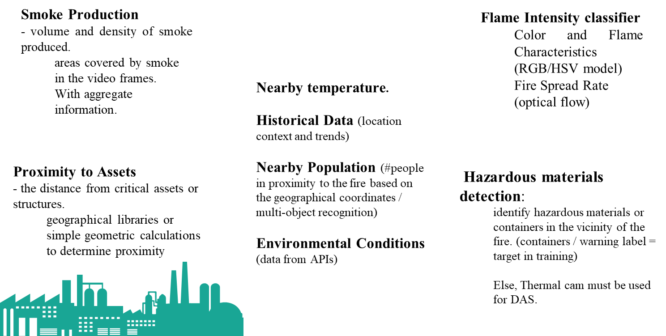
Design & Experimentation

Slide 15
Design & Experimentation
Model Training & Optimization Strategy:
Dataset: Open source + Custom dataset
NC: 7 (Fire, People, Hazardous/Inflammable materials(5))
Includes Multi-scale fire (Industrial fire, wildfire, etc.)
Real + Augmented
Training:
Transfer Learning from PeopleNet (enterprise grade) for class ‘people’.
Optimization:
Evaluate, Prune, Evaluate, Fine-Tune and Quantize.
Export:
TensorRT .engine format.
Metrics: mAP@0.50, recall, FPS.

Slide 16
Results obtained till date
Dataset & Model:
Number of TBs: 0.051 TBs
Data type (video, LiDAR, voice, text, etc.): Video (RGB), fully annotated images.
Collected in house or open source: Custom in-house data and certain open-source datasets.
No personal or restricted data involved.
Approximate number of parameters (for custom or foundation AI models): 86.7M parameters.
Geographic location where the data is stored: Secure local SSDs. (Coimbatore, India)

Slide 17
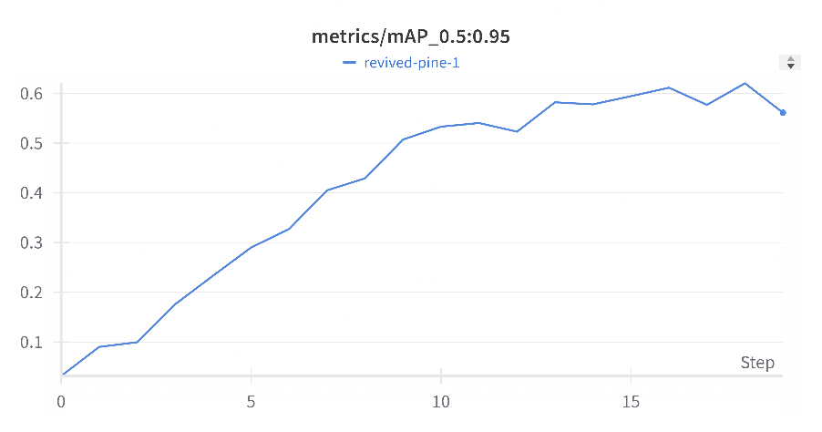
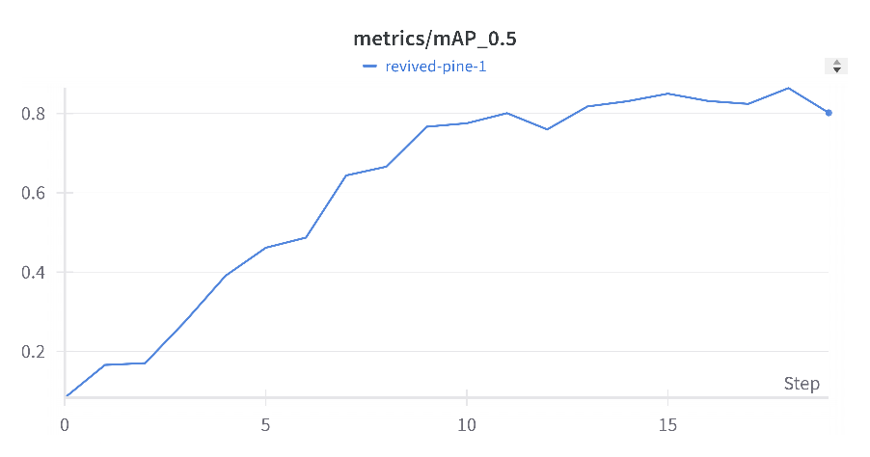
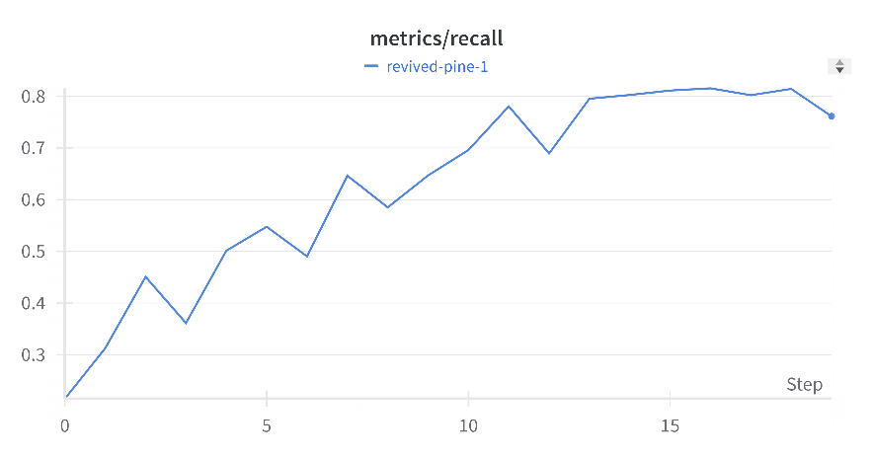
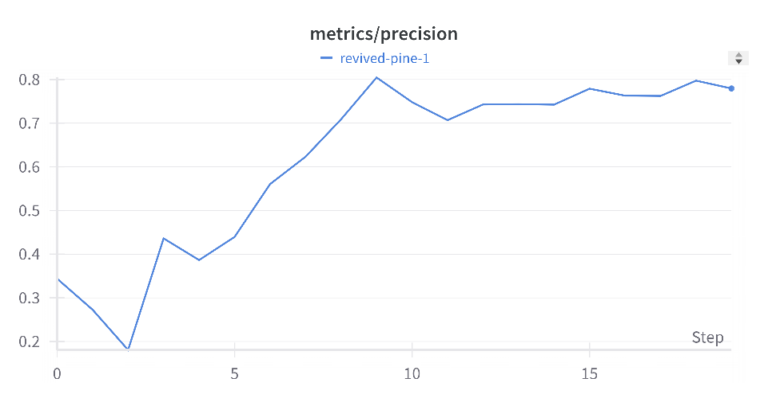
Results obtained till date
YOLOv5 (Downgraded to support edge device CUDA compatibility)
https://wandb.ai/syndicate/YOLOv5/workspace?nw=nwusermohankrishnagr08

Slide 18
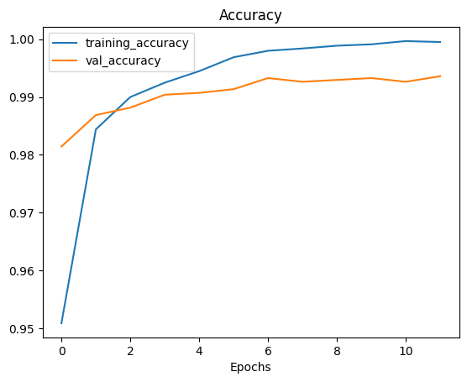
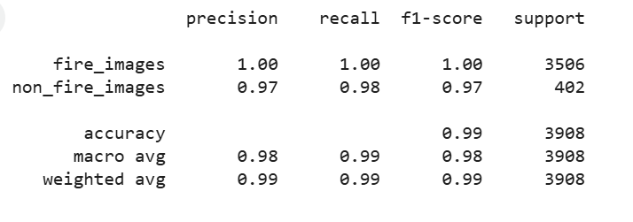
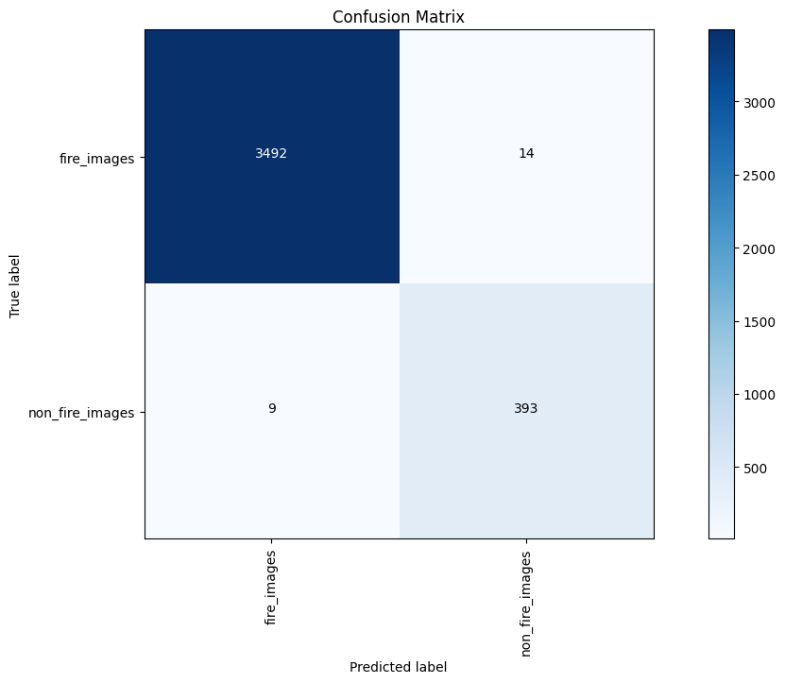
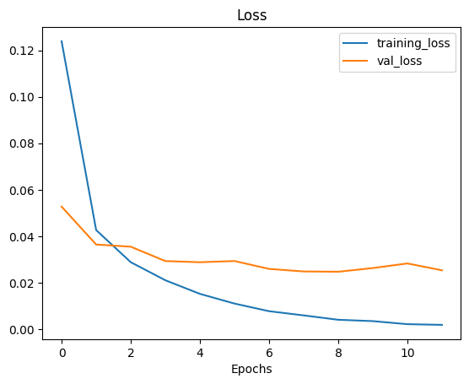
Results obtained till date
MobileNetv2
https://colab.research.google.com/drive/1gnJky_zKnsOmowJbsdIRGTXzKWZXlko?usp=sharing

Slide 19
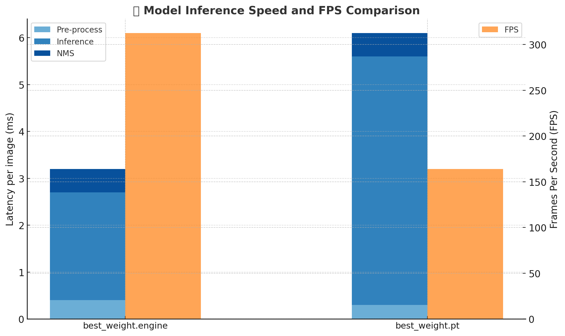
Results obtained till date

Slide 20

Results obtained till date

Slide 21
Upgradation
Upgrading to Jetson Orin Nano will enable to run state-of-the art models in the edge, also would give wider CUDA compatibility, DeepStream 7.1 SDK.
Total cost = ₹ 37,800

Slide 22
Proposed Project Outcome
Global Replicability and Scalability: A modular, adaptable system that can be deployed in diverse geographical regions, making it a globally scalable solution for fire detection and disaster management.
Early Warning System: Develop a fully functional early warning system that can alert local authorities and communities within minutes of fire detection, significantly reducing response time and potentially saving lives and property.
Deployment: A ready-to-use, real-world solution for fire detection and severity classification.(~ Huge Industries, Fire & Rescue Services, Local Governments and communities, Forest Department).
Research Output: Submit findings to top-tier conferences (e.g., IEEE ICIP, CVPR) and journals.
Community Contribution: Share the system design, datasets, and code on GitHub under an open-source license.

Slide 23
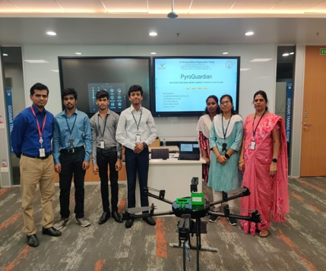

Outcomes (Patent, Paper, Hackatons etc.,) – applied / published / granted
Hackathon:
Runner-up in Honeywell Drones Technology Hackathon
Received ₹25,000 cash prize.

